Slide 1
Dissertation Proposal Defense A Texas Cross Sectional Study: Evaluating Infection Prevention Examination Rates and Training Practices
Kayla Elizabeth Ruch, MPH, CPH, HACP, CIC

Slide 2
Hypothesis, Research Questions, Specific Aims or Objectives
AIM 1: Analyze CBIC's CIC® exam pass rates and content areas to identify individual core content and overall exam passing trends.
AIM 2: Develop and conduct a qualitative infection prevention training and core competency-focused survey to infection preventionists in Texas to collect information on training and orientation practices.
AIM 3: Based on the data collected from Aims 1 and 2, education training recommendations will be constructed based on core competencies infection preventionists reported as strengths and weaknesses.
SUB AIM 3: Evaluate educational material from Texas Epidemic Public Health Institute (TEPHI) Infection Control Series educational modules developed for rural healthcare infection preventionists and other healthcare professionals responsible for the facility’s infection prevention and control program.

Slide 3
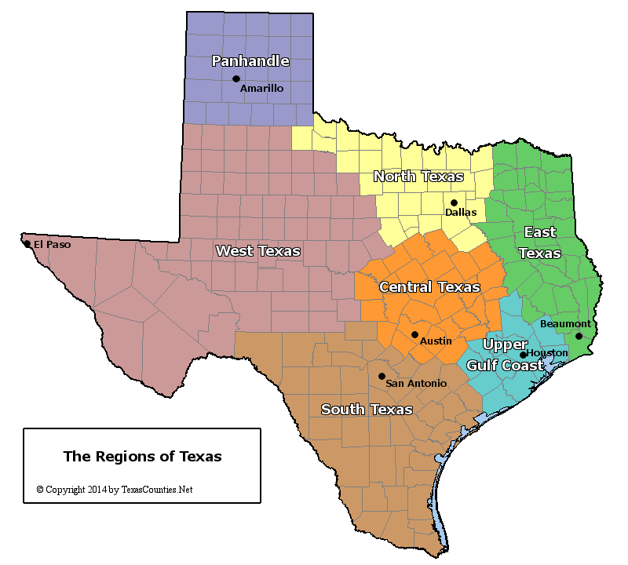
Methods: Aim 2
AIM 2: Develop and conduct a qualitative infection prevention training and core competency-focused survey to infection preventionists in Texas to collect information on training and orientation practices.
Study Population: Infection preventionists who currently serve as APIC members in the state of Texas from October 2023 to March 2024.
Survey Software: Qualtric^{XM}
Survey Dissemination Plan: APIC chapter membership list for the following Texas Chapters:
Dallas-Fort Worth, Houston, San Antonio, Rio Grande Valley, Central (Austin) Texas, Heart of Texas/ East Texas, and Paso Del Norte
Survey will be posted on IP forums to include non-APIC Texas Members
Survey Type: Anonymous self reported
Survey Questions and Type: 54 close-ended question and 1 open-ended question
Notes:
survey questions previously coded based on literature review

Slide 4
Methods: Aim 2
Data Analysis:
Descriptive statistics based on survey
Bivariate and multivariate logistic regression
The confounding level will be determined if there is a 10% change in effect.
Effect modifiers will be determined if there is a 10% change in effect
Subgroup analysis will be conducted based on facility-type acute care, long-term care, and skilled nursing home healthcare settings to ensure facility likewise comparison and years of IP experience. Results will be stratified based on healthcare setting to control for differences in patient populations, service lines, and state regulations
Data Handling: Complete case analysis
Data Software: . STATA Version 17

Slide 5
Questions

Slide 6
References
1. Billings C, Volkman J. APIC Text: Competency and Certification of Infection Preventionists. https://text.apic.org/toc/overview-of-infection-prevention-programs/competency-and-certification-of-infection-preventionists. 2022. Accessed January 15, 2023.
2. APIC. Novice Roadmap for the Infection Preventionist - APIC. APIC. 2021. https://apic.org/professional-practice/roadmap/novice-roadmap-for-the-infection-preventionist. Accessed March 27, 2023
3. Holmes, K, McCarty, J, Steinfeld, S. APIC Text: Infection prevention and control programs- APIC.APIC. https://text.apic.org/toc/overview-of-infection-prevention-programs/infection-prevention-and-control-programs. 2021. Accessed March 10, 2023
4. Meyer R, Buechel K, Tobey K, et al. Content Review of Public Health Infection Control Efforts During the COVID-19 Pandemic. Am J Infect Control. 2022;50(7):S5. doi:10.1016/j.ajic.2022.03.123.
5. Fast Facts on U.S. hospitals, 2023 | AHA. American Hospital Association. https://www.aha.org/statistics/fast-facts-us-hospitals. Accessed April 1, 2023
6. APIC. Who are infection preventionists? - APIC. APIC. https://apic.org/monthly_alerts/who-are-infection-preventionists/. Published March 30, 2023. Accessed December 29, 2022
7. APIC. Become an IP: Start a career in Infection Prevention and Control - APIC. APIC. https://apic.org/what-is-an-infection-preventionist/?gclid=Cj0KCQiAic6eBhCoARIsANlox84fECyCpahNjeddkLEg6n0uzeh4NMB6dv9Vu6THBuYOVE88BKYi8KUaAqFBEALw_wcB. Published April 11, 2023. Accessed January 10, 2023.
8. Davis J, Billings C, Malik C. Revisiting the Association for Professionals in Infection Control and Epidemiology Competency Model for the Infection Preventionist: An evolving conceptual framework. Am J Infect Control. 2018;46(8):921-927. doi:10.1016/j.ajic.2018.04.210
9. Gilmartin H, Smathers S, Reese SM. Infection preventionist retention and professional development strategies: Insights from a national survey. Am J Infect Control. 2021;49(7):960-962. doi:10.1016/j.ajic.2021.04.083
10. Exam & Certification FAQ | CBIC. https://www.cbic.org/CBIC/Exam-and-Certification-FAQ.htm. Accessed January 18, 2023.

Slide 7
References
11. FAQs: Surgical Site Infections (SSI) events | NHSN | CDC. https://www.cdc.gov/nhsn/faqs/faq-ssi.html. Accessed August 3, 2023
12. Crist K, Murphy D, Wright MO, Wallace E, Manning ML. The role of the infection preventionist in a transformed healthcare system: Meeting healthcare needs in the 21st century. Am J Infect Control. 2019 Apr;47(4):352-357. doi: 10.1016/j.ajic.2019.02.003.
13. Gilmartin H, Reese SM, Smathers S. Recruitment and hiring practices in United States infection prevention and control departments: Results of a national survey. Am J Infect Control. 2021;49(1):70-74. doi:10.1016/j.ajic.2020.07.024
14. Gould M, Dietzler S, Ehlert B, et al. Roadmap for onboarding a new infection preventionist: One health care system's approach. Am J Infect Control. 2021;49(11):1427-1428. doi:10.1016/j.ajic.2021.06.009
15. Kenneley I. Education and Training. In: Boston K.M. et al., eds..2014 APIC Text.https://text.apic.org/toc/overview-of-infection-prevention-programs/education-and-training 1/33. Accessed January 25, 2023.
16. North Carolina Department of Health and Human Services. Healthcare-associated infections (HAIs). https://epi.dph.ncdhhs.gov/cd/diseases/hai.html#:~:text=The%20U.S.%20Centers%20for%20Disease,33%20billion%20in%20excess%20costs. 2020. Accessed February 4, 2023.
17. Arias, K.M. Surveillance. In: Boston K.M. et al., eds. 2020. APIC Text.https://text.apic.org/toc/epidemiology-surveillance-performance-and-patient-safety-measures/surveillance. Accessed February 12, 2023.
18. National Healthcare Safety Network (NHSN) Patient Safety Component Manual. 2023. https://www.cdc.gov/nhsn/pdfs/pscmanual/pcsmanual_current.pdf. Accessed January 6, 2023.
19. The World Health Organization. WHO launches first-ever global report on infection prevention and control. 2022. https://www.who.int/news/item/06-05-2022-who-launches-first-ever-global-report-on-infection-prevention-and-control. Accessed February 19, 2023.
20. Certification Board of Infection Control and Epidemiology, Inc. Recertification by infection prevention Units (IPUs) overview. 2019. https://www.cbic.org/CBIC/Recertify/Recertification-by-Continuing-Education.htm. Accessed February 24, 2023.
21. The Centers for Disease Control and Prevention. National Healthcare Safety Network (NHSN). https://www.cdc.gov/nhsn/index.html. Accessed March 5, 2023

Slide 8
References
22. Kalp EL, Harris JJ, Zawistowski G. Predictors of certification in infection prevention and control among infection preventionists: APIC MegaSurvey findings. Am J Infect Control. 2018;46(8):858-864. doi:10.1016/j.ajic.2018.05.004
23. Stata Statistical Software: Release 17. College, Station, TX: StataCorp LLC
24. Health topics - HAI - POLARIS. Centers for Disease Control and Prevention. https://www.cdc.gov/policy/polaris/healthtopics/hai/index.html#:~:text=On%20any%20given%20day%2C%201,occur%20in%20other%20healthcare%20setting. Published June 21, 2021. Accessed April 17, 2023
25. CBIC. CIC®. https://www.cbic.org/CBIC/CIC-Certification/About-the-Examination.htm. Accessed July 14, 2023.
26. CBIC. CIC® by the numbers. https://www.cbic.org/CBIC/2021-cic-by-the_59124629.png. Accessed July 14, 2023
27. CBIC. Guidelines for CIC® Initial Certification. https://www.cbic.org/CBIC/Candidate-Handbook/Eligibility-Guidelines.htm. Accessed July 14, 2023
28. Marx JF, Callery S, Boukidjian R. Value of certification in infection prevention and control. Am J Infect Control. 2019;47(10):1265-1269. doi:10.1016/j.ajic.2019.04.169
29. CBIC. Exam Prep. https://www.cbic.org/CBIC/Exam-Prep-Resources.htm. Accessed on July 27, 2023
30. APIC. CIC® Certification. https://learnipc.apic.org/cic-certification/. Accessed on July 27, 2023
31. Landers T, Davis J, Crist K, Malik C. APIC MegaSurvey: Methodology and overview. Am J Infect Control. 2017;45(6):584-588. doi:10.1016/j.ajic.2016.12.012
32. Pogorzelska-Maziarz M, Monsees E, Hessels A. APIC Megasurvey 2020: Methodology and overview of results. Am J Infect Control. 2023;51(3):241-247. doi:10.1016/j.ajic.2022.12.002

