Slide 1
APIC Chapter Update – July 2025
Government Affairs Committee
(This presentation includes updates from May, June and July)
Mary Lavis, BSN, RN, CIC
7/8/25

Slide 2
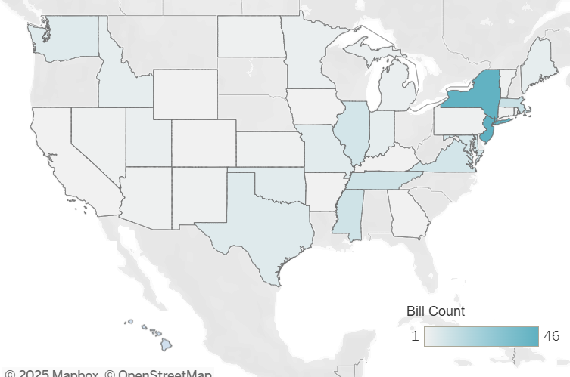
State Legislative Update

Slide 3
State Legislative Update
Date Filed | Action | Title/Ch./Rules/SB/HB | Topic / Comments
10/31/2024 | Died | 25 TAC §§97.3, 97.4, 97.6 | The amendment to §97.3 adds melioidosis and Cronobacter spp. in infants as notifiable conditions in Texas. The amendments to §97.4 and to §97.6 acceptable methods of reporting notifiable conditions to electronic data transmission, telephone, or fax.
11/13/2024 | Referred to State Affairs 03/10/25 - Died | HJR 91 | Proposing a constitutional amendment recognizing the right of an individual to refuse a vaccination.
11/15/2024 | Referred to Public Health 03/11/25 - Died | HB 1356 | Relating to prohibited health care discrimination based on vaccination status; providing a civil penalty.
11/25/2024 | SB 407 referred to HHS 02/03/25, HB1468 referred to Public Health 03/11/25 -Died | HB 1468 & SB 407 | Proposing healthcare facilities be unable to reject any vaccine exemption based on reasons of conscience , including religious belief, or for any reason
11/12/2024 | Referred to Trade, Workforce & Economic Development 02/28/25 - Died | HB 383 | Relating to prohibiting a private employer from adopting or enforcing COVID-19 vaccine mandates; authorizing an administrative penalty.
11/12/2024 | Referred to Public Health 02/28/25 - Died | HB 468 | Gives Texas Legislature final approval on any new vaccinations required by schools
11/12/2024 | Referred to Education K-16 02/03/2025 - Died | SB 118/HB 3440 | Relating to the repeal of the authority to exclude certain students without certain required immunizations from attending public school in times of emergency or epidemic.
02/03/2025 | Referred to Human Services 03/14/25 - Died | HB 2374 | Relating to infection prevention and control programs and other communicable diseases measures at certain long-term care facilities; authorizing an administrative penalty.
02/25/2025 | Referred to Public Health 03/21/25- Died | HB 3304 | Relating to a prohibition on vaccine mandates.
Notes:
https://apic.org/state-legislation/

Slide 4
State Legislative Update
HB 4535 passed and was signed by Governor Abbott. This bill requires patients to sign a form prior to receiving a COVID-19 vaccine that explains the following:
The "expedited manner" in which the COVID-19 vaccine was developed.
If any long-term studies have been performed on the vaccine
If vaccine manufacturers are subject to civil liability
How to access VAERS
Goes into effect: September 1st, 2025
The bill states Texas DSHS will provide the consent form.
You can read the bill here: https://capitol.texas.gov/BillLookup/history.aspx?LegSess=89R&Bill=HB4535

Slide 5
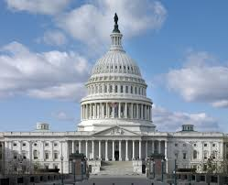
Federal Legislative
Update

Slide 6
Federal Legislative Update
05/07 - CDC terminates the Healthcare Infection Control Practices Advisory Committee (HICPAC). APIC, IDSA and SHEA issued a joint statement calling for reinstatement of HICPAC. Currently, APIC is supporting evidence-based guidelines. There is concern that a HICPAC 2.0 may include members that are not going to represent IP interests.
05/27 -RFK announces the CDC no longer recommends COVID-19 boosters for healthy children and pregnant women
06/09 - RFK dismisses all 17 members of CDC's vaccine advisory committee (ACIP)
06/11 - New ACIP members are announced, some new members are known for the vaccine skepticism. Now a total of 7 voting members.
06/25 - 06/26 (ACIP meeting)
  CDC adopts ACIP advice to lower RSV vaccine age threshold from 60 to 50 for high-risk adults. Approved inclusion of a new RSV monoclonal antibody (Clesrovimab)
  Voted to stop recommending influenza vaccines containing thimerosal
    American Academy of Pediatrics leaders condemned the ACIP agenda and has stated it will continue to publish its own guidance on vaccination.
07/04 - "One Big Beautiful Bill" passes. There is an estimated 7 – 11 million* people who will lose Medicaid coverage. Experts expect largest impact to rural hospitals.
07/07- AAP, IDSA, APHA, SMFM, MPHA and a pregnant physician filled suit in American Academy of Pediatrics vs. RFK in the U.S. District Court for the Distri t of Massachusetts to defend vaccine policy
*The house, senate and news reports varied estimates between 10 – 17 million, the most reliable estimates place loss around 10 million people
Notes:
https://apic.org/apic-federal-letters/

Slide 7

Take Action
APIC DFW GAC wrote a letter supporting vaccination and public health that was sent to our Texas representatives
We need you to use your voice…
The President has released his final budget proposal for FY 2026. With the passage of a Continuing Resolution (CR) to flat fund the federal government for FY 2025, it is important to advocate now for funding infection prevention and control priorities in FY 2026, particularly as Congress completes its budget work and turns to its appropriations work. Numbers matter – the more messages Congress and the Administration get from their constituents the more they pay attention.
Scan the QR code to send a letter!

Slide 8
Questions? Thank you!
Thank you to our APIC DFW GAC Team!
Jasmine Cluck
Patti Grant
Rachel Watson

Slide 9
APIC DFW Education Session- The State of Legislative Affairs
Original presentation by:
Carol McLay, DrPH, MPH, CIC, FAPIC, FSHEA
Lisa L. Tomlinson, MA, CAE

Slide 10
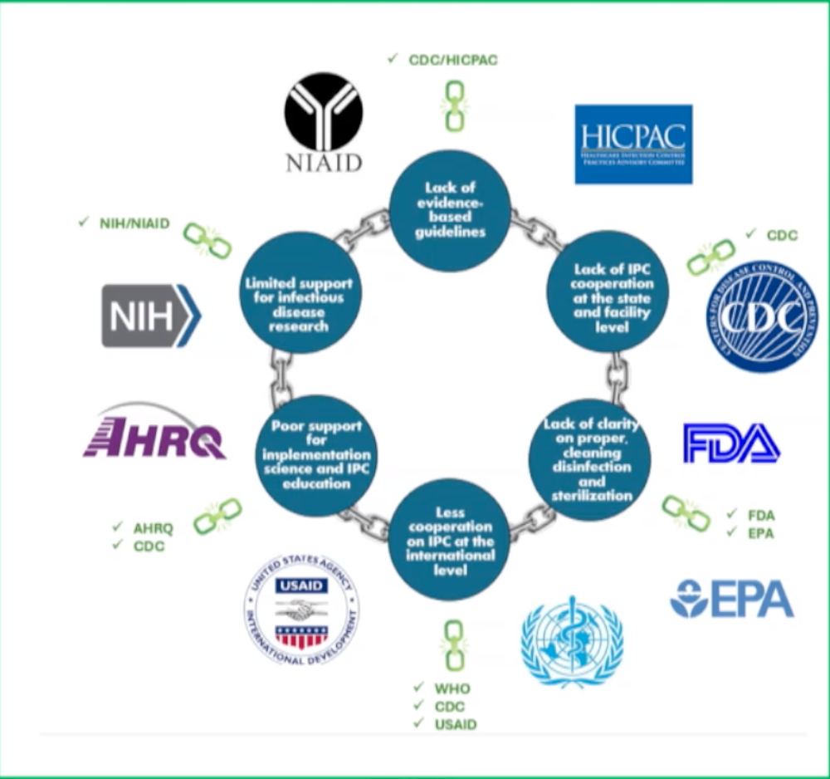
The Federal Role in Breaking the "Chain of Infection"
Notes:
The blue circles represent gaps and challenges faced by IPC, then the green is support provided by the federal government
Support historically is bipartisan

Slide 11
State and Local IPC Support
Clawback of Federal CDC Grants
Administration announced they were reclaiming $11 billion in grants that were already awarded to states and local health departments
Major reductions in grant funding included ELC (Epidemiology and Lab Capacity) and COVID relief funds
These grants help states and communities detect and respond to infectious disease threats specific to their region
President's FY 26 Budget
Proposed $40 million for the ELC program
Proposed elimination of the Healthcare-Associated Infectious grant program – which did help support NHSN in some capacity

Slide 12
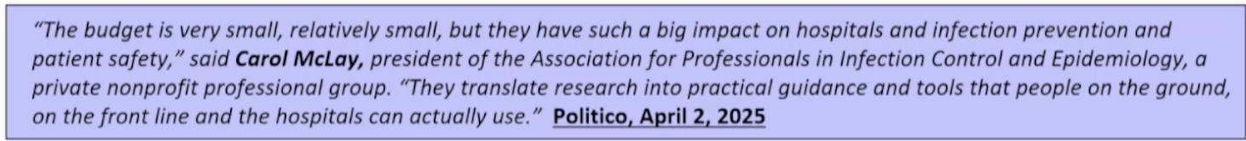
Implementation Science and Education
Agency for Healthcare Research and Quality (AHRQ) role in HAI Reduction will be eliminated as part of the FY26 Budget Request
AHRQ toolkits turn research into real-world solutions, providing healthcare facilites with practical, evidence-based tool kits to make care safer for everyone
AHRQ's Comprehensive Unit-based Safety Program (CUSP) contributed to reduction in HAIs from 99,000 in 2002 to 72,000 today
Reduction in HAIs saved billions of dollars in healthcare costs

Slide 13
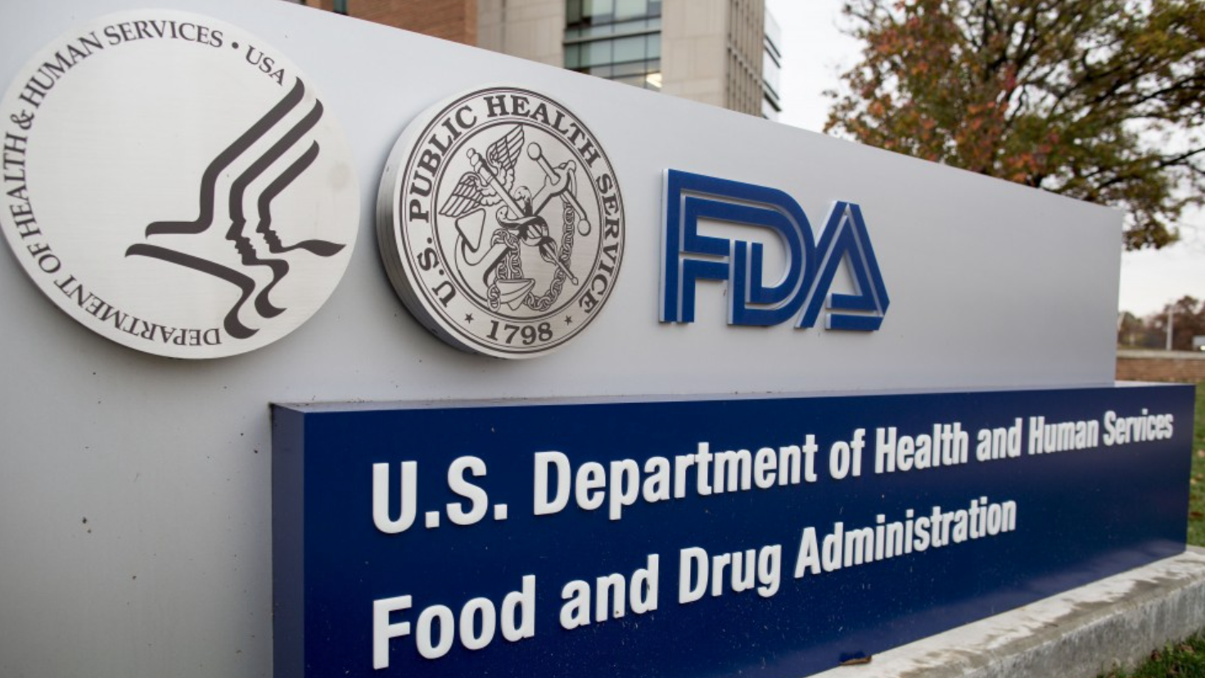
Cleaning, Disinfection and Sterilization Expertise
FDA had 3,500 positions eliminated
Some probationary employees laid off by DOGE were reinstated
President's FY 26 Budget for FDA
$6.8 billion (a decrease from $272 million)
$3.6 billion in user fees (increase of $132 million)
$235 million for the FDA to implement MAHA priorities (investing in nutrition, removing harmful chemicals from food and packaging, addressing system food safety failures, and supporting laboratory operations)
Notes:
Impact IP is currently feeling is that FDA is slower to respond, less avaliable to provide support or answer questions

Slide 14

Infectious Disease Research
1,165 employees eliminated
FY26 Budget for NIH is $27.5 billion (a reduction of $18 billion, almost 40%)
FY26 Budget for NIAID is $4.2 billion (a reduction of $2.4 billion of 36%)
The Administration has recommended reducing NIH's 27 institutes into 8, but NIAID is expected to remain intact

Slide 15
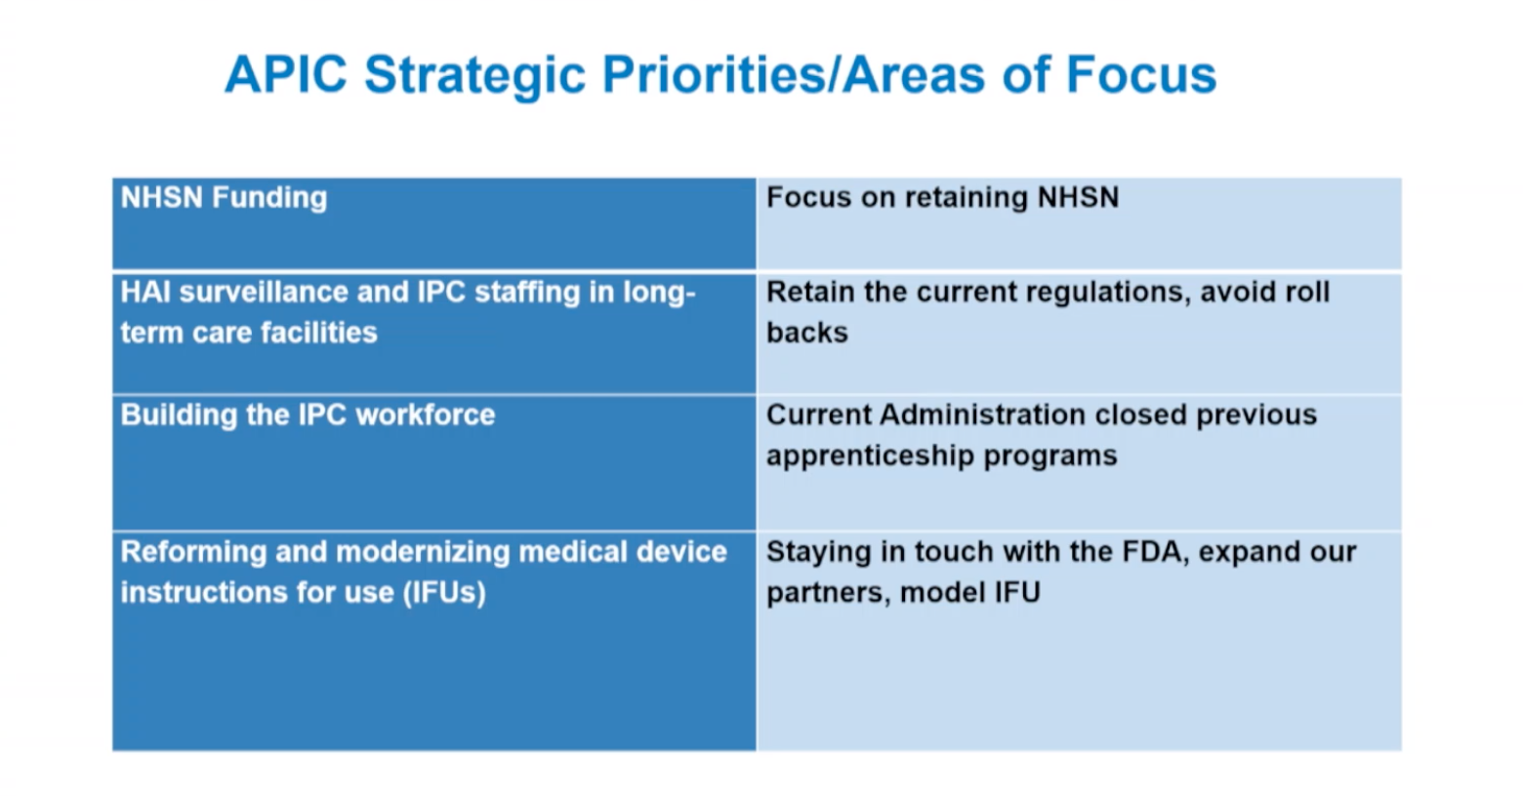

Slide 16
Questions? Thank you!

