Slide 1
APIC Chapter Update – April 2025
Government Affairs Committee
Mary Lavis, BSN, RN, CIC
4/3/2025

Slide 2
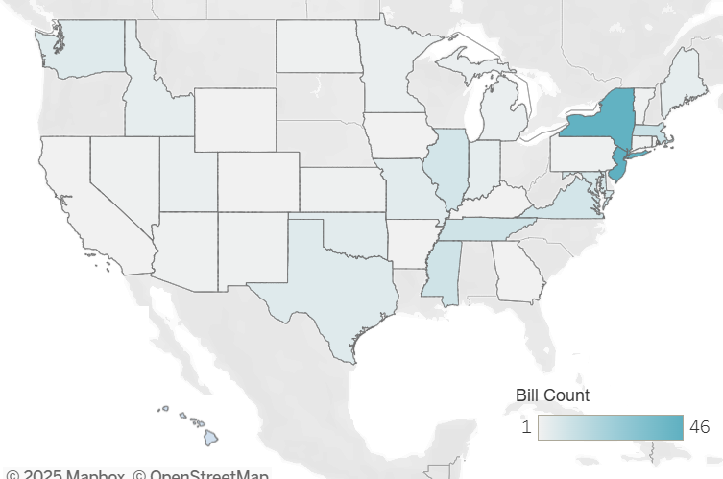
State Legislative Update

Slide 3
State Legislative Update
Date Filed | Action | Title/Ch./Rules/SB/HB | Topic / Comments
10/31/2024 |  | 25 TAC §§97.3, 97.4, 97.6 | The amendment to §97.3 adds melioidosis and Cronobacter spp. in infants as notifiable conditions in Texas. The amendments to §97.4 and to §97.6 acceptable methods of reporting notifiable conditions to electronic data transmission, telephone, or fax.
11/13/2024 | Referred to State Affairs 03/10/25 | HJR 91 | Proposing a constitutional amendment recognizing the right of an individual to refuse a vaccination.
11/15/2024 | Referred to Public Health 03/11/25 | HB 1356 | Relating to prohibited health care discrimination based on vaccination status; providing a civil penalty.
11/25/2024 | SB 407 referred to HHS 02/03/25, HB1468 referred to Public Health 03/11/25 | HB 1468 & SB 407 | Proposing healthcare facilities be unable to reject any vaccine exemption based on reasons of conscience , including religious belief, or for any reason
11/12/2024 | Referred to Trade, Workforce & Economic Development 02/28/25 | HB 383 | Relating to prohibiting a private employer from adopting or enforcing COVID-19 vaccine mandates; authorizing an administrative penalty.
11/12/2024 | Referred to Public Health 02/28/25 | HB 468 | Gives Texas Legislature final approval on any new vaccinations required by schools
11/12/2024 | Referred to Education K-16 02/03/2025 | SB 118/HB 3440 | Relating to the repeal of the authority to exclude certain students without certain required immunizations from attending public school in times of emergency or epidemic.
02/03/2025 | Referred to Human Services 03/14/25 | HB 2374 | Relating to infection prevention and control programs and other communicable diseases measures at certain long-term care facilities; authorizing an administrative penalty.
02/25/2025 | Referred to Public Health 03/21/25 | HB 3304 | Relating to a prohibition on vaccine mandates.
Notes:
https://apic.org/state-legislation/

Slide 4
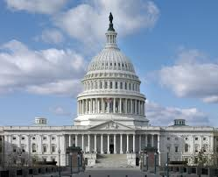
Federal Legislative
Update

Slide 5
Federal Legislative Update
03/05 – HHS rescinded the policy allowing public participation in rulemaking
03/26 – President nominates Susan Monarez, Ph.D. as Director of CDC
03/26 – IPs, Epidemiologists, and ID Physicians Ask HHS to Support HICPAC
APIC, SHEA, IDSA, and the Pediatric Infectious Diseases Society (PIDS) sent a joint letter to HHS Secretary Kennedy opposing the possible elimination of HICPAC. The letter identifies the many ways HICPAC makes healthcare safer by providing evidence-based guidance on infection prevention and control practices.
04/02 – The U.S. Department of Health and Human Services announced a reorganization to comply with the President’s order to reduce the workforce. The restructuring, which is expected to take place in late May, 2025, will reduce HHS staff by about 20,000 full-time employees. Among changes that could impact IPC are: moving NIOSH from CDC to a newly-created Administration for a Healthy America; moving ASPR to CDC; combining AHRQ with the office of the Assistant Secretary for Planning and Evaluation (ASPE) into a new Office of Strategy; and combining CMS with the Administration for Children and Families (ACF) to create a new Administration for Community Living (ACL).
Notes:
https://apic.org/apic-federal-letters/

Slide 6

Take Action
APIC GAC wrote a letter supporting vaccination, and that is currently being reviewed by APIC national to ensure it’s aligned.
We need you to use your voice…
CDC’s HICPAC is under consideration for elimination. Please write to your federal policymakers to let them know how important HICPAC guidelines are to IPC practices in your facility and your state. Numbers matter – the more messages Congress and the Administration get from their constituents the more they pay attention.
Scan the QR code to send a letter!

Slide 7
Questions? Thank you!

