Slide 1




Research Readiness Series:
This is SO abstract! Demystifying Abstract Writing Workshop
October 18, 2024: APIC DFW Annual Conference
Notes:
** BIG GOAL- to get APIC DFW members present at the meetings, submit abstracts, and become fellows!!
Timeline for both presentations:
Objectives for topic by end of May
Presentation (at least draft), by September 1
Final presentation by October 1
*** Fellow- publication piece is a big barrier- author process. Research cohort?? Special interest group- after two initial presentations-

Slide 2
Objectives
Explain the purpose and structure of an effective abstract
Identify best practices for APIC abstract submissions
Develop an abstract draft for the national APIC conference
Describe the major principles in presenting engaging and informative abstracts and research
Notes:
Here and in the rest of the slides- include a QR code to the references, materials, checklist, poster template? Have on the APIC DFW site or the Tarrant County IP Council site?

Slide 3

Why Submit an Abstract?
Knowledge sharing
Elevate Your Practice
Elevate your Facility
Fellowship Status
Networking
Notes:
~3 minutes. Abstract: self-contained, short overview that describes a larger work (Kate Gase- APIC)

Slide 4


APIC Submission: Do’s and Don’ts
APIC Abstract Submission Quick Facts:
~360 abstract proposals are submitted; ~150 are accepted
~50% of abstracts are rejected for not following submission guidelines
Spell out acronyms even common ones like “IP”, “CDC”, “CAUTI” | Skip out on reading the submission guidelines!
Remove facility names and any identifiers, brands, or trades | Include bulleted lists, tables, or figures
Write in English only | Write in incomplete sentences or use first person anecdotes
Write out three learning objectives | Do not submit an abstract that has been previously published or presented at a national or international conference
Keep it within the word limit (300 words, excluding the title)! | Forget to screen your abstract for spelling and grammatical errors with FREE software!
Have a co-worker or peer review for clarity and adherence to the submission guidelines | Let the deadline pass!!
Notes:
~ 5 minutes

Slide 5

Abstract Structure 101
Title
Background
Methods
Results
Conclusion
Brief, describes abstract content (20 word limit)
“What is the importance of the study?”- present tense
Background and describe study objectives, hypothesis tested, and/or problem solved
Five Study S’s : Describe study intervention (variables) & design, setting, sample, subjects, stats- past tense
Essential results with statistical analysis- past tense
“So what?”- present tense
No numbers besides time frame and sample size!
Map result to each method and in same order!
Interpret, importance, implications. Map to each result
Notes:
~ 3 minutes. Include examples here!

Slide 6

Word Count Conundrum
  Use acronyms after you have spelled out the term once
  Ensure you have covered the basics/requirements
  Limit the number of methods in the abstract and provide the most important results that are relative to the methods described
  Once accepted for presentation you can add back the rest of your methods and results to the poster/presentation
“A way there always is”

Slide 7
APIC DFW Abstract Examples
Highlight “how-to”:
  Title
  Background
  Methods
  Results
  Conclusions
Notes:
~ 4 minutes. Include examples here! We can also engage the audience here and ask what abstract strengths are and how they followed the guidelines?
Example from APIC 2021 published abstract and Poster presentation

Slide 8
Factors Related to the Accurate Application of NHSN Surveillance Definitions for CAUTI and CLABSI in Texas Hospitals
Teri Mauldin, Jennifer Adams, Christi Zumwalt, Karen Yates, Diana Cervantes, Tera Ashe, Menghua Tao
, , , , , ,
Title: Clearly describes the content of the abstract.
Background- Previous studies indicate inconsistent knowledge and application of the National Healthcare Safety Network (NHSN) surveillance definitions used to report Healthcare Associated Infections (HAI). Our study aims to determine factors associated with accurate application of the surveillance criteria.
Background: The significance of the issue and the study aim; present tense.
Answers: “What is the importance of the study?”

Slide 9
, , , , , ,
Factors Related to the Accurate Application of NHSN Surveillance Definitions for CAUTI and CLABSI in Texas Hospitals
Teri Mauldin, Jennifer Adams, Christi Zumwalt, Karen Yates, Diana Cervantes, Tera Ashe, Menghua Tao
Methods-Members of Texas Infection Prevention (IP) professional organizations were emailed a web-based survey in January 2020. Respondents answered demographic and other questions related to the 2019 NHSN training completed and applied NHSN definitions to case scenarios on Catheter-Associated Urinary Tract Infection (CAUTI) and Central Line-Associated Bloodstream Infection (CLABSI). This cross-sectional study used logistic regression models to estimate associations between years of experience, hours spent on surveillance, NHSN training, and respondents’ ability to identify the correct HAI criteria.
Methods: Study 5 S’s addressed and in the past tense.

Slide 10
, , , , , ,
Factors Related to the Accurate Application of NHSN Surveillance Definitions for CAUTI and CLABSI in Texas Hospitals
Teri Mauldin, Jennifer Adams, Christi Zumwalt, Karen Yates, Diana Cervantes, Tera Ashe, Menghua Tao
Methods-Members of Texas Infection Prevention (IP) professional organizations were emailed a web-based survey in January 2020. Respondents answered demographic and other questions related to the 2019 NHSN training completed and applied NHSN definitions to case scenarios on Catheter-Associated Urinary Tract Infection (CAUTI) and Central Line-Associated Bloodstream Infection (CLABSI). This cross-sectional study used logistic regression models to estimate associations between years of experience, hours spent on surveillance, NHSN training, and respondents’ ability to identify the correct HAI criteria.
Methods: Study 5 S’s addressed and in the past tense.
(Study Design)

Slide 11
, , , , , ,
Factors Related to the Accurate Application of NHSN Surveillance Definitions for CAUTI and CLABSI in Texas Hospitals
Teri Mauldin, Jennifer Adams, Christi Zumwalt, Karen Yates, Diana Cervantes, Tera Ashe, Menghua Tao
Methods-Members of Texas Infection Prevention (IP) professional organizations were emailed a web-based survey in January 2020. Respondents answered demographic and other questions related to the 2019 NHSN training completed and applied NHSN definitions to case scenarios on Catheter-Associated Urinary Tract Infection (CAUTI) and Central Line-Associated Bloodstream Infection (CLABSI). This cross-sectional study used logistic regression models to estimate associations between years of experience, hours spent on surveillance, NHSN training, and respondents’ ability to identify the correct HAI criteria.
Methods: Study 5 S’s addressed and in the past tense.
(Setting)

Slide 12
, , , , , ,
Factors Related to the Accurate Application of NHSN Surveillance Definitions for CAUTI and CLABSI in Texas Hospitals
Teri Mauldin, Jennifer Adams, Christi Zumwalt, Karen Yates, Diana Cervantes, Tera Ashe, Menghua Tao
Methods-Members of Texas Infection Prevention (IP) professional organizations were emailed a web-based survey in January 2020. Respondents answered demographic and other questions related to the 2019 NHSN training completed and applied NHSN definitions to case scenarios on Catheter-Associated Urinary Tract Infection (CAUTI) and Central Line-Associated Bloodstream Infection (CLABSI). This cross-sectional study used logistic regression models to estimate associations between years of experience, hours spent on surveillance, NHSN training, and respondents’ ability to identify the correct HAI criteria.
Methods: Study 5 S’s addressed and in the past tense.
(Sample and Subjects)

Slide 13
, , , , , ,
Factors Related to the Accurate Application of NHSN Surveillance Definitions for CAUTI and CLABSI in Texas Hospitals
Teri Mauldin, Jennifer Adams, Christi Zumwalt, Karen Yates, Diana Cervantes, Tera Ashe, Menghua Tao
Methods-Members of Texas Infection Prevention (IP) professional organizations were emailed a web-based survey in January 2020. Respondents answered demographic and other questions related to the 2019 NHSN training completed and applied NHSN definitions to case scenarios on Catheter-Associated Urinary Tract Infection (CAUTI) and Central Line-Associated Bloodstream Infection (CLABSI). This cross-sectional study used logistic regression models to estimate associations between years of experience, hours spent on surveillance, NHSN training, and respondents’ ability to identify the correct HAI criteria.
Methods: Study 5 S’s addressed and in the past tense.
(Stats). Note- no numbers besides timeframe!

Slide 14
, , , , , ,
Factors Related to the Accurate Application of NHSN Surveillance Definitions for CAUTI and CLABSI in Texas Hospitals
Teri Mauldin, Jennifer Adams, Christi Zumwalt, Karen Yates, Diana Cervantes, Tera Ashe, Menghua Tao
Results -Eighty-eight IPs responded to the survey. Twenty-five of 65 respondents (38%) who completed CAUTI training identified the correct CAUTI criterion, and 6 of 63 (10%) who completed CLABSI training identified the correct CLABSI criterion. CAUTI training was associated with higher odds of accurately identifying CAUTI (Odds Ratio (OR) = 4.92, 95% Confidence Interval (CI): 1.2, 20.5) after adjusting for years of experience and hours spent on surveillance. Similar patterns of association were observed between completion of CLABSI training and correctly identifying CLABSI, but the result was not significant (OR = 2.35, 95% CI: 0.2, 23.8). Compared to those spending less time on NHSN surveillance (< 6 hours/week), those spending more time (>16 hours/week) had lower odds of identifying CAUTI but higher odds of identifying CLABSI.
Results: Essential results to address the study aim. Stats are used to map each result to a method; written in the past tense.

Slide 15
, , , , , ,
Factors Related to the Accurate Application of NHSN Surveillance Definitions for CAUTI and CLABSI in Texas Hospitals
Teri Mauldin, Jennifer Adams, Christi Zumwalt, Karen Yates, Diana Cervantes, Tera Ashe, Menghua Tao
Results -Eighty-eight IPs responded to the survey. Twenty-five of 65 respondents (38%) who completed CAUTI training identified the correct CAUTI criterion, and 6 of 63 (10%) who completed CLABSI training identified the correct CLABSI criterion. CAUTI training was associated with higher odds of accurately identifying CAUTI (Odds Ratio (OR) = 4.92, 95% Confidence Interval (CI): 1.2, 20.5) after adjusting for years of experience and hours spent on surveillance. Similar patterns of association were observed between completion of CLABSI training and correctly identifying CLABSI, but the result was not significant (OR = 2.35, 95% CI: 0.2, 23.8). Compared to those spending less time on NHSN surveillance (< 6 hours/week), those spending more time (>16 hours/week) had lower odds of identifying CAUTI but higher odds of identifying CLABSI.
Results: Essential results to address the study aim. Stats are used to map each result to a method; written in the past tense.

Slide 16
, , , , , ,
Factors Related to the Accurate Application of NHSN Surveillance Definitions for CAUTI and CLABSI in Texas Hospitals
Teri Mauldin, Jennifer Adams, Christi Zumwalt, Karen Yates, Diana Cervantes, Tera Ashe, Menghua Tao
Results -Eighty-eight IPs responded to the survey. Twenty-five of 65 respondents (38%) who completed CAUTI training identified the correct CAUTI criterion, and 6 of 63 (10%) who completed CLABSI training identified the correct CLABSI criterion. CAUTI training was associated with higher odds of accurately identifying CAUTI (Odds Ratio (OR) = 4.92, 95% Confidence Interval (CI): 1.2, 20.5) after adjusting for years of experience and hours spent on surveillance. Similar patterns of association were observed between completion of CLABSI training and correctly identifying CLABSI, but the result was not significant (OR = 2.35, 95% CI: 0.2, 23.8). Compared to those spending less time on NHSN surveillance (< 6 hours/week), those spending more time (>16 hours/week) had lower odds of identifying CAUTI but higher odds of identifying CLABSI.
Results: Essential results to address the study aim. Stats are used to map each result to a method; written in the past tense.

Slide 17
, , , , , ,
Factors Related to the Accurate Application of NHSN Surveillance Definitions for CAUTI and CLABSI in Texas Hospitals
Teri Mauldin, Jennifer Adams, Christi Zumwalt, Karen Yates, Diana Cervantes, Tera Ashe, Menghua Tao
Conclusions- Limited studies demonstrate variability in the accuracy of definitions of NHSN surveillance. Possible factors contributing to this variability are also lacking. Our results suggest that recent NHSN training and more years of IP experience may be associated with increased accuracy of HAI identification. However, spending more time with NHSN surveillance every week may not improve one's ability to identify CAUTI.
Conclusion: Answers “So What?” in present tense- interpretations, importance, implication!

Slide 18
, , , , , ,
Factors Related to the Accurate Application of NHSN Surveillance Definitions for CAUTI and CLABSI in Texas Hospitals
Teri Mauldin, Jennifer Adams, Christi Zumwalt, Karen Yates, Diana Cervantes, Tera Ashe, Menghua Tao
Conclusions- Limited studies demonstrate variability in the accuracy of definitions of NHSN surveillance. Possible factors contributing to this variability are also lacking. Our results suggest that recent NHSN training and more years of IP experience may be associated with increased accuracy of HAI identification. However, spending more time with NHSN surveillance every week may not improve one's ability to identify CAUTI.
Conclusion: Answers “So What?” in present tense- interpretations, importance, implication!

Slide 19
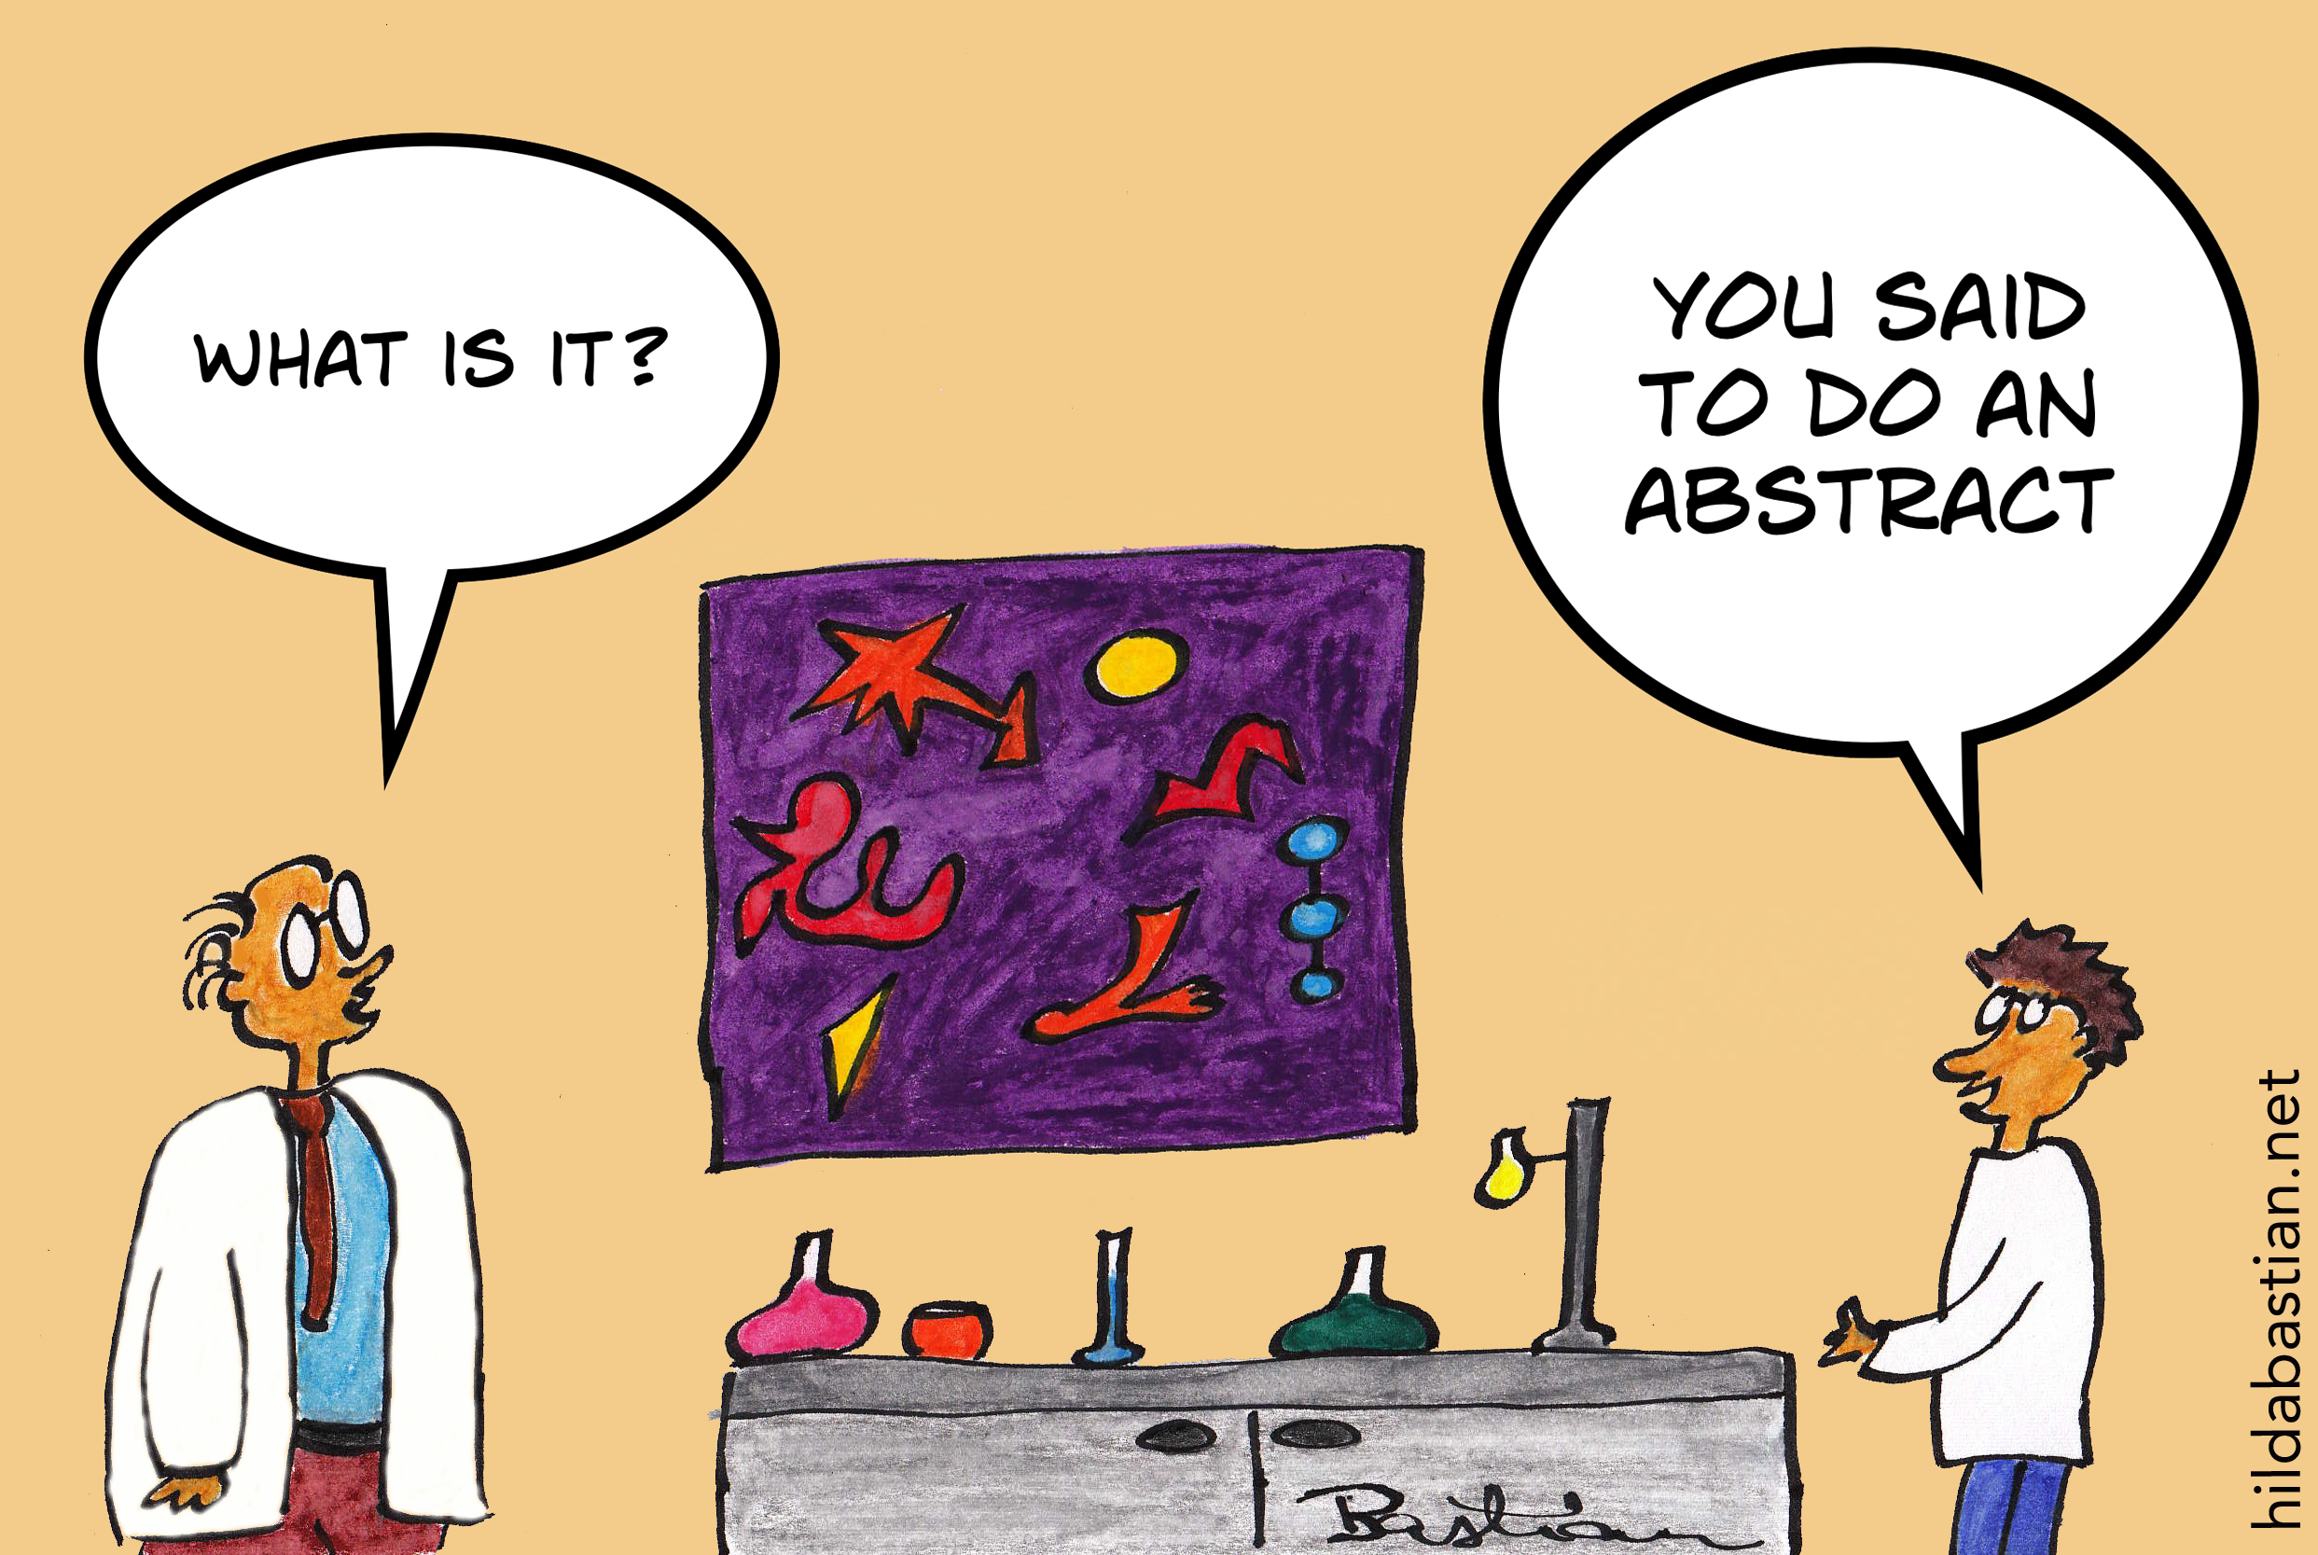

Applied Abstracting!
Use the Abstract Writing: Step-by-Step Guide & Checklist to write your abstract draft
  Switch with your partner
  Share with the group!
Notes:
~ 25 minutes. Add QR code to checklist/provide hard copies too!

Slide 20
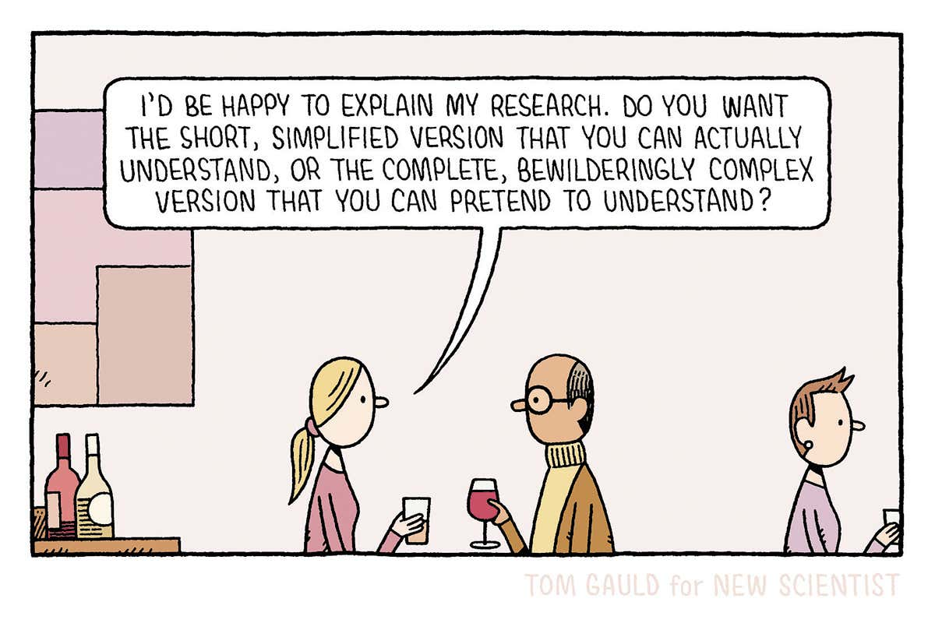
Abstract Accepted!
Next Steps to Engaging Presentation
Keep things simple
Use graphics and pictures
Tell your story with examples!
  Our brains better understand a narrative
Use technology- QR codes, Polls
  Do not rely on it; have a backup plan if you have a podium presentation!
Notes:
~ 7 minutes. Here we can also highlight use some presentations and posters from APIC members to highlight engaging presentations!

Slide 21
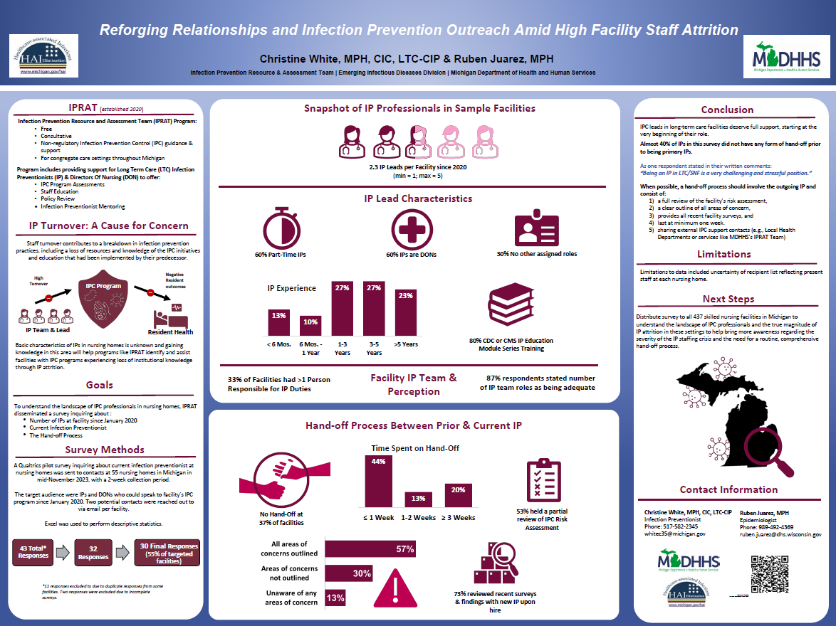
Notes:
~ 7 minutes. Here we can also highlight use some presentations and posters from APIC members to highlight engaging presentations!

Slide 22
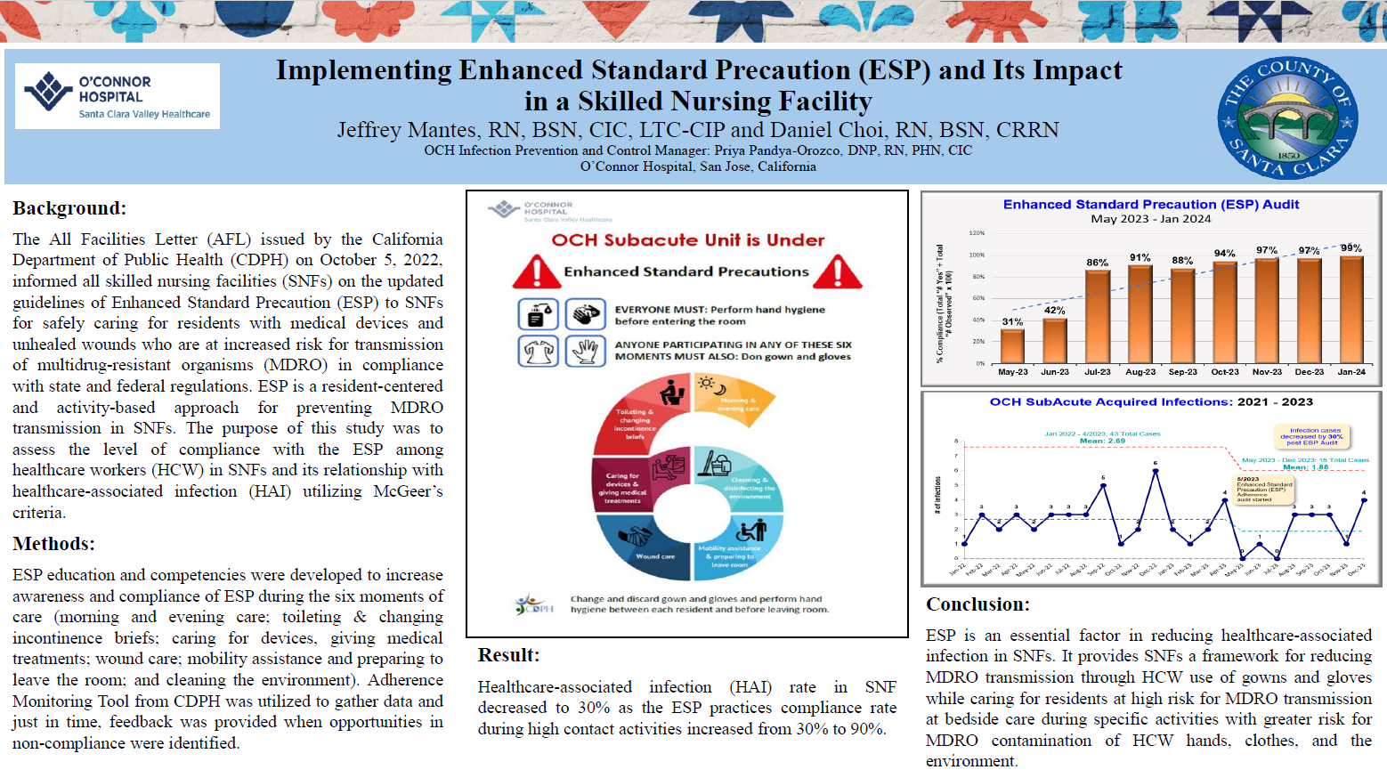
Notes:
~ 7 minutes. Here we can also highlight use some presentations and posters from APIC members to highlight engaging presentations!

Slide 23
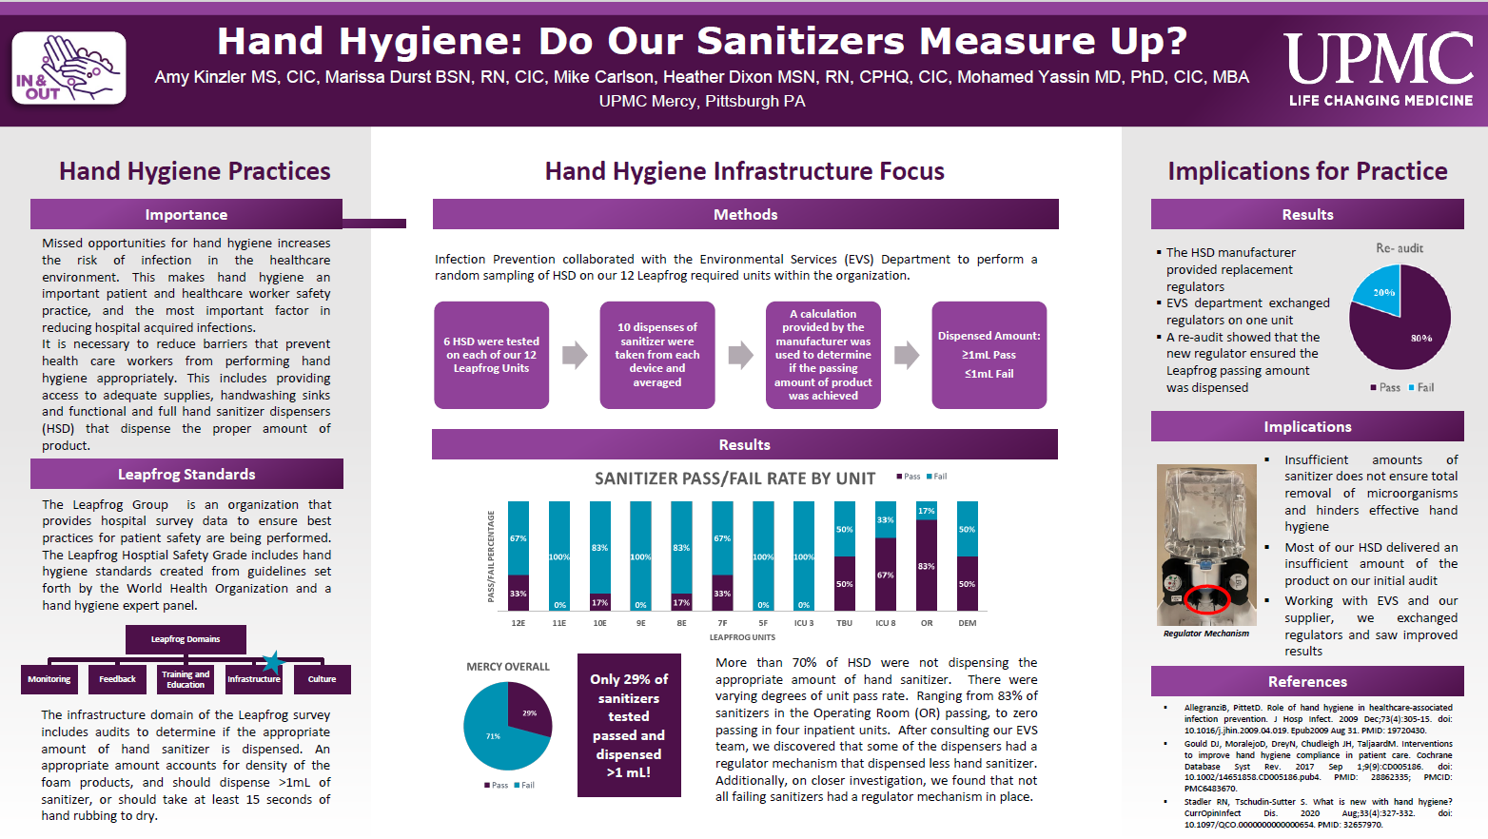
Notes:
~ 7 minutes. Here we can also highlight use some presentations and posters from APIC members to highlight engaging presentations!

Slide 24
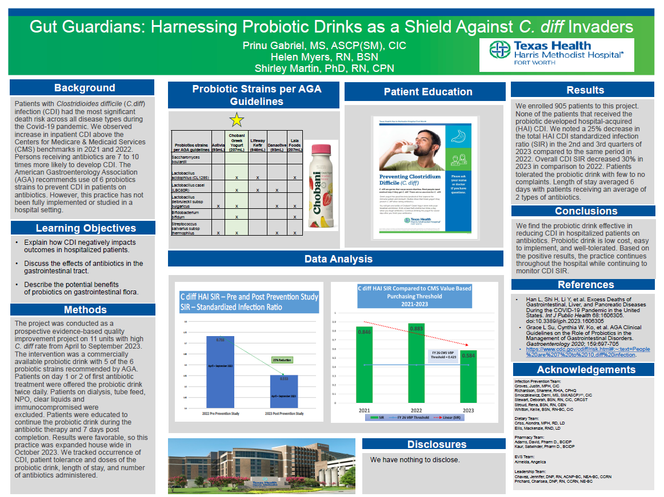
Notes:
~ 7 minutes. Here we can also highlight use some presentations and posters from APIC members to highlight engaging presentations!

Slide 25


Session Wrap-Up
Submission deadline: TBD
You are the foundation of IP science- your work needs to be out there!
APIC-DFW- present your accepted abstract!
Need Help? Let’s work together!
  Research readiness anonymous peer review
  Complete the interest survey by Friday, November 1st
Notes:
~ 3 minutes. We can ask participants

Slide 26

References & Resources
APIC 5-second rule on writing an abstract: https://5secondruleshow.org/episode/56-apic-abstract-review-trent-mcallister/
APIC 2022 conference: writing an abstract and peer reviewed articles- https://www.youtube.com/watch?v=4GV_h18cIw0
Writing Scientific Abstracts. Kate Gase, APIC Research Committee Chair. https://industryperspectives.com/wp-content/uploads/2016/10/4_Writing-scientific-abstracts.pdf
Pointers for a Successful Abstract Submission, Prevention Strategist- Summer 2017. https://apic.org/Resource_/TinyMceFileManager/Periodical_images/PS_Summer_2017_Abstract_submission.pdf
AJIC Reasons for rejection of abstracts submitted o the APIC conference: https://www.ajicjournal.org/article/S0196-6553(18)30952-0/abstract

Slide 27
References & Resources
Factors related to the accurate application of NHSN surveillance definitions for CAUTI and CLABSI in Texas hospitals. Mauldin, T., Adams, J., Zumwalt, C., Yates, K., Cervantes, D., Ashe, T., & Tao, M. https://doi.org/10.1016/j.ajic.2021.04.066
Reforging Relationships and Infection Prevention Outreach Amid High Facility Staff Attrition. C. White & R. Juarez. https://doi.org/10.1016/j.ajic.2024.04.038
Implementing Enhanced Standard Precaution (ESP) and Its Impact in a Skilled Nursing Facility. J. Mantes and D. Choi. https://doi.org/10.1016/j.ajic.2024.04.037

Slide 28
References & Resources
Hand Hygiene: Do our Sanitizers Measure Up? A. Kinzler, M. Durst, M. Carlson, H. Dixon, M. Yassan. https://doi.org/10.1016/j.ajic.2024.04.058
Gut Guardians: Harnessing Probiotic Drinks as a Shield Against C. diff Invaders. P. Gabriel, H. Myers, S. Martin. https://doi.org/10.1016/j.ajic.2024.04.013
Free, online grammar checkers
  Grammarly: https://www.grammarly.com/grammar-check
  QuilBot: https://quillbot.com/grammar-check

